Slide 1
GeTable
Table Reservation app
Information system analysis
Nariman Mansour
Fall 2020

Slide 2
Team Members :
Ghazar
Mohamad Nour
Alireza

Slide 3

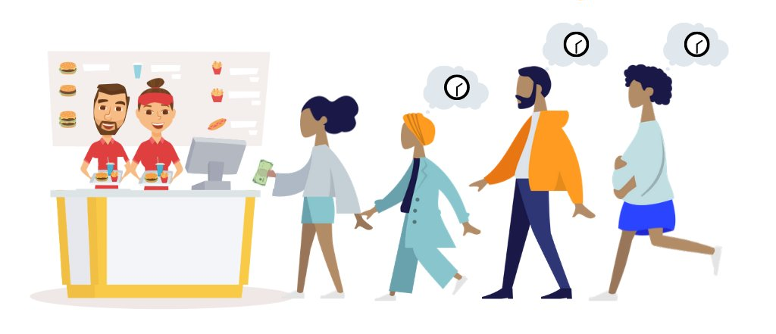
We call a restaurant to make a reservation and nobody answers
we wait a lot of time to get our order

Slide 4
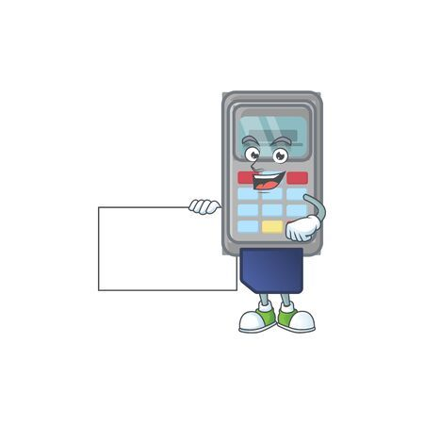

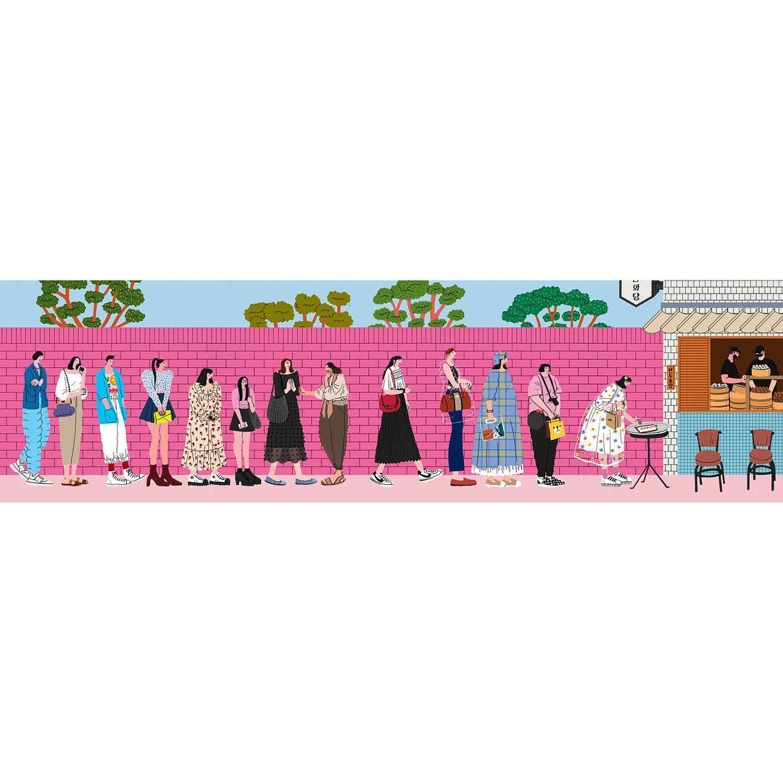
A lot of us feel uncomfortable to pay by credit/debit machine,
we wait on the line a lot of time just to pay our bills

Slide 5
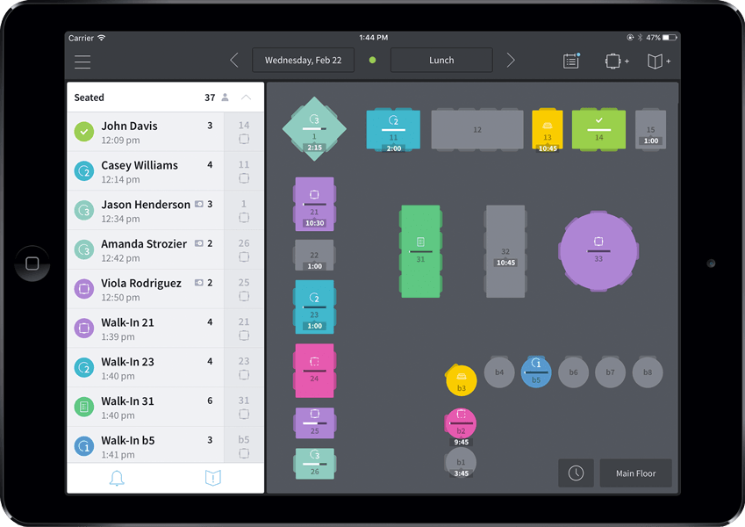




Our Goal
GeTable
Increase the profit of the restaurant
Better experience for clients
Save their time
Better control on reservation

Slide 6
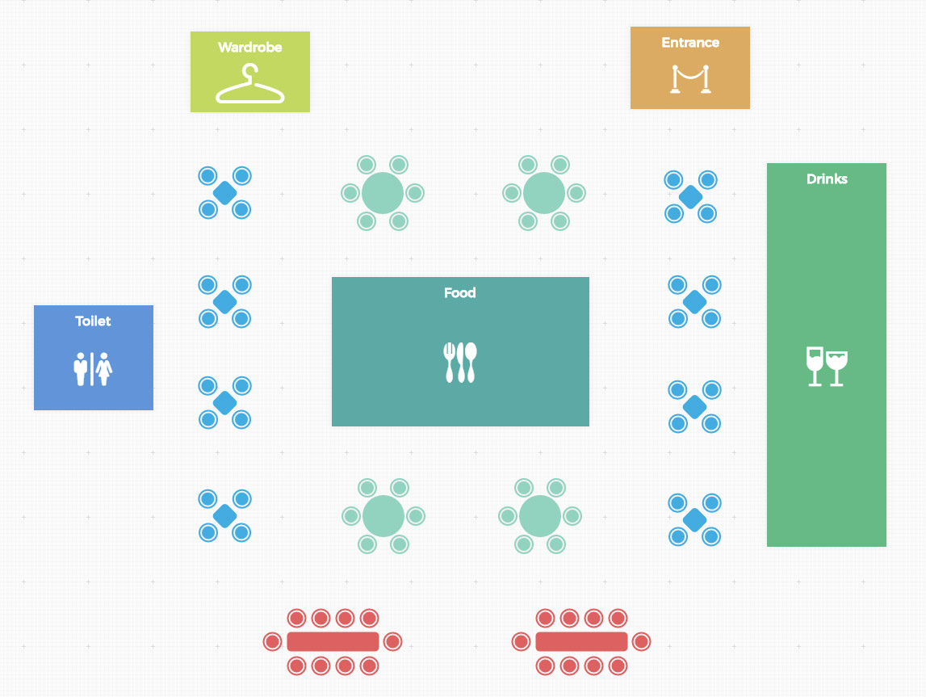
What will we do?
Getable
Application that let users reserve their favorite tables
Users can order
Users can pay

Slide 7

How does GeTable works?
Users create an account in the app
They can search about their favorite restaurants
They can access to the availability of the tables in the restaurant in order to reserve a table
Users can access to the menu of the restaurant to order their food.
If they want , they can pay by our app or in the restaurant

Slide 8
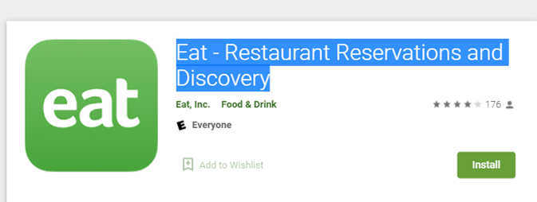
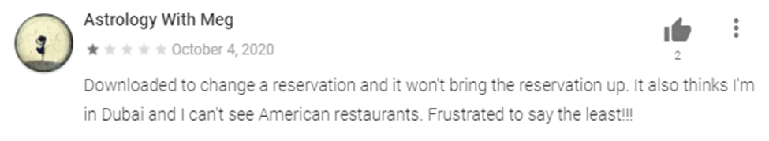
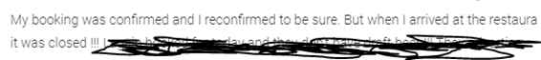
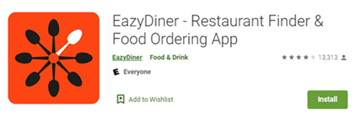
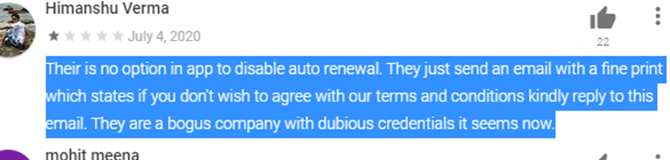
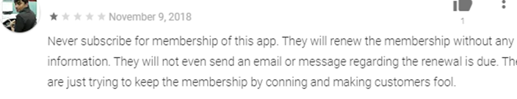
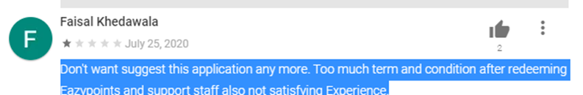
Data is not captured in time to be useful; the app cannot follow the location of the user
Data is not captured
Costs are too high in some app such as EazyDiner , and people are complaining about membership renewal
Too much information about policy, and users are lost
Not easy to use
There is a problem for example if the customer reserve a table, and he/she does not come

Slide 9

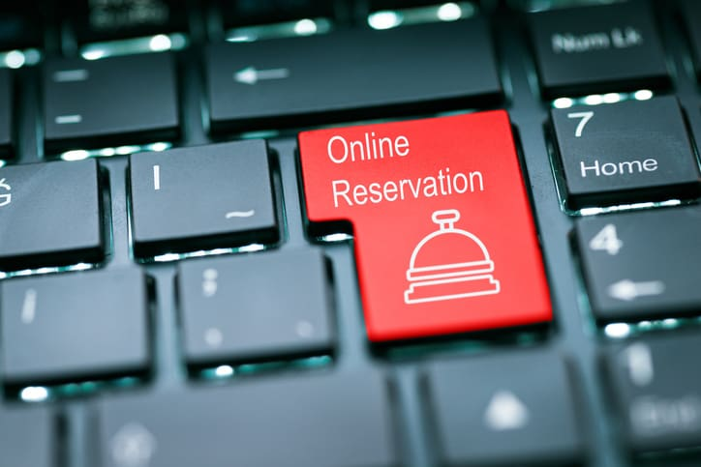
Functional requirements:
It lets users search about the restaurants.
It will send confirmations of resaving the tables and receipt to the users.
Cancel reservation or change reservation
Calculate the amount of the orders, and if the users cancel the reservation, it will show fees that he/she has to pay.
It will accept just the time for the reservation that restaurant will decide
It will show the favorite dish weekly based on the number of likes
It will show the processing of the cooking

Slide 10

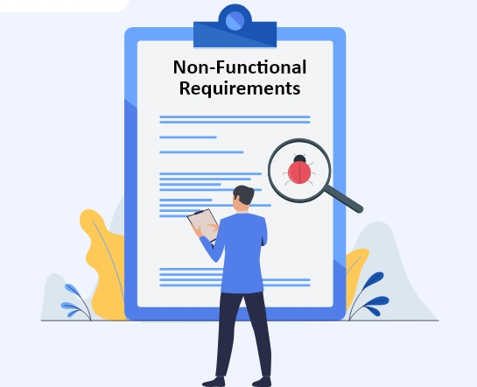
Non-Functional Requirements
Use encryption to avoid bots from booking.
System should accept payments via various payment methods.
Easy to use , efficient and accessible.
Default currency is based on the location that app is using (for example in Canada you will pay by Cad and in US you will pay by USD )
• Give permission to the users to change the language based on the location

Slide 11
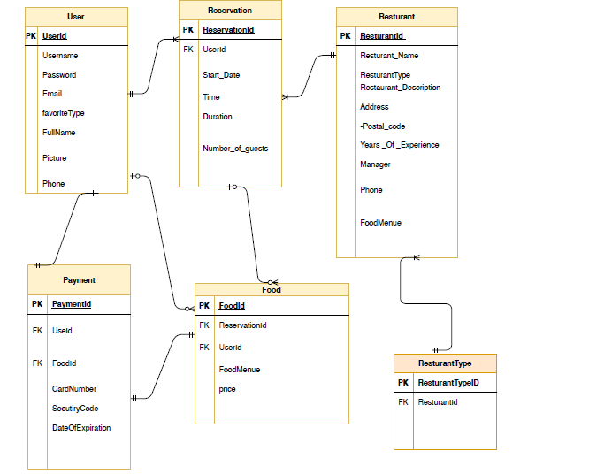
ERD

Slide 12
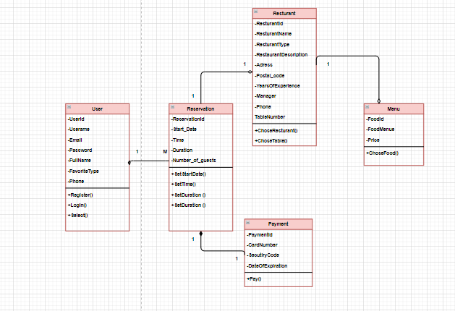
Class diagram

Slide 13
Operational Details
INFORMATION WE COLLECT AND USE
HOW WE SHARE YOUR INFORMATION
Personal information
Contact details
Dining details
Payment details
Location information
Your name and your GeTable
Protected by cryptographic protocols
We do not have direct control over customers information

Slide 14
User story
As a user | I want to order food by the app | So, I can track the processing of cooking, before I arrive | By ordering meal, the app will direct you to page of processing
As a user | I want to reschedule my reservation | So I can change the date of my reservation and time | By Clicking on change button when you reserve , you can reschedule your reservation
As a user | I want to pay may meal in the app. | So I can have a safe payment and save my time. | By ordering meal, app will direct you to payment page.
As a user | I want to find restaurant on map | So I can find out the distance, and find nearest restaurants. | Can search by Map on the separate page.

Slide 15

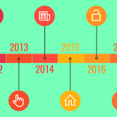
FEASIBILTY STUDY
G E T A B L E
ECONOMIC
FEASIBILTY
TIME LINE

Slide 16
MILESTONES
Feasibility study
deployment
Planning
testing
System requirements
coding
design

Slide 17

Planning
System requirements
Design
Feasibility Study
1–NOV–2020
Coding
Testing
Deployment
31-Dec-2020
1-Jan-2021
31-Jan2021
1-fab-2021
28-Fab-2021
1-March-2021
30-April-2021
1-April-2021
30-April-2021
1-May-2021
31-May-2021
PERT
2 Months
1 Month
1 Month
1 Month
1 Month
To be delivered on : 1-Jun-2021
It will take : 7 months.
2 Months

Slide 18
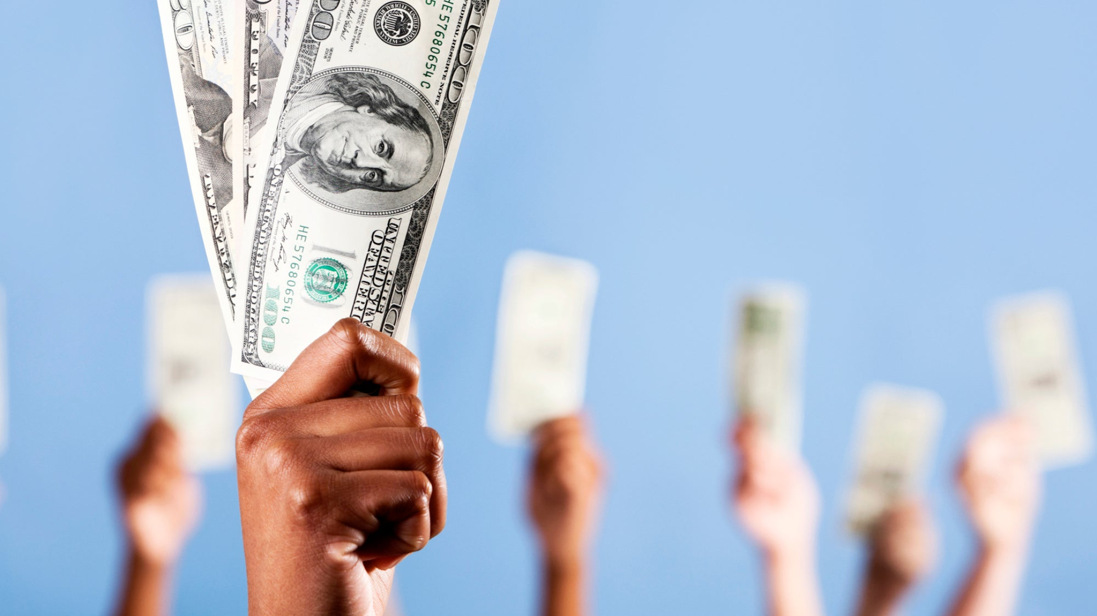
Benefits
revenue
- Free for costumers
-2.5$ per reservation
-potential annual fees
-our goal 109.500 reservation/year

Slide 19

WHAT DO WE NEED ?

Slide 20

Feasibility study
Planning
System requirements
design
coding
testing
deployment
coding
testing
Project manager
Quality
lead
Support
team
servers
Expert
programmers
Software architect
hardware
Programming
languages
Testing
team
Business Analyst

Slide 21
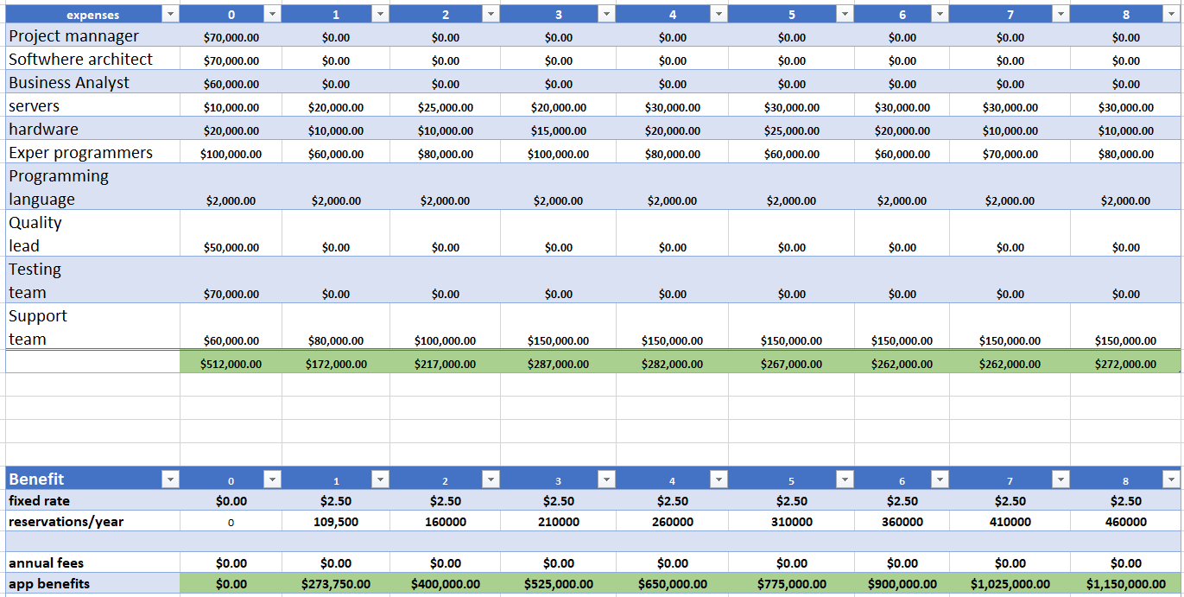

Slide 22
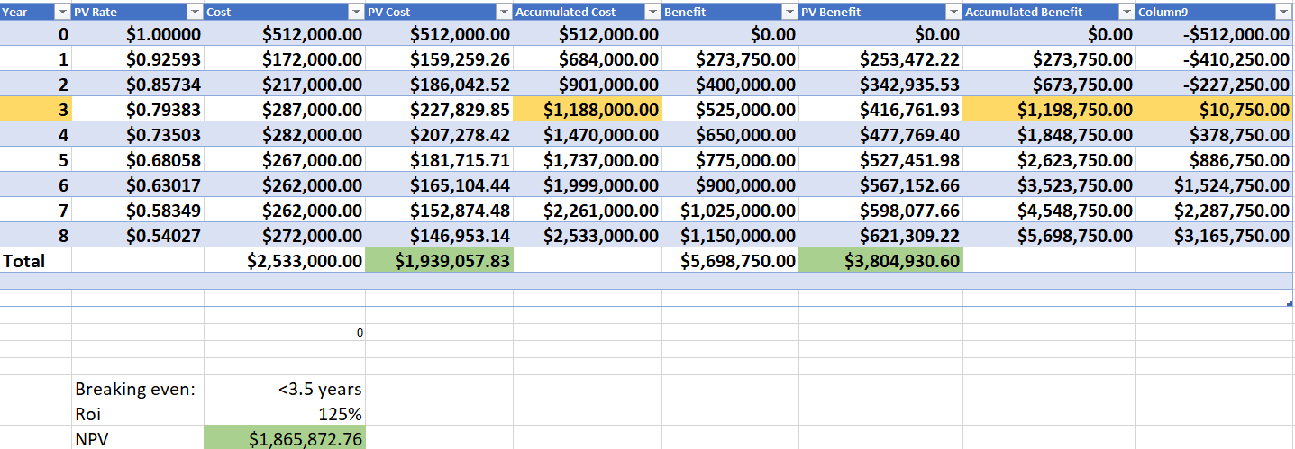
Cost And Benefits :

Slide 23
Use Case
- User register in the app to reserve a table
- Search for restaurants
- Reserve a table
- Reschedule
- Restaurants manage their reservations
- Add new restaurants

Slide 24
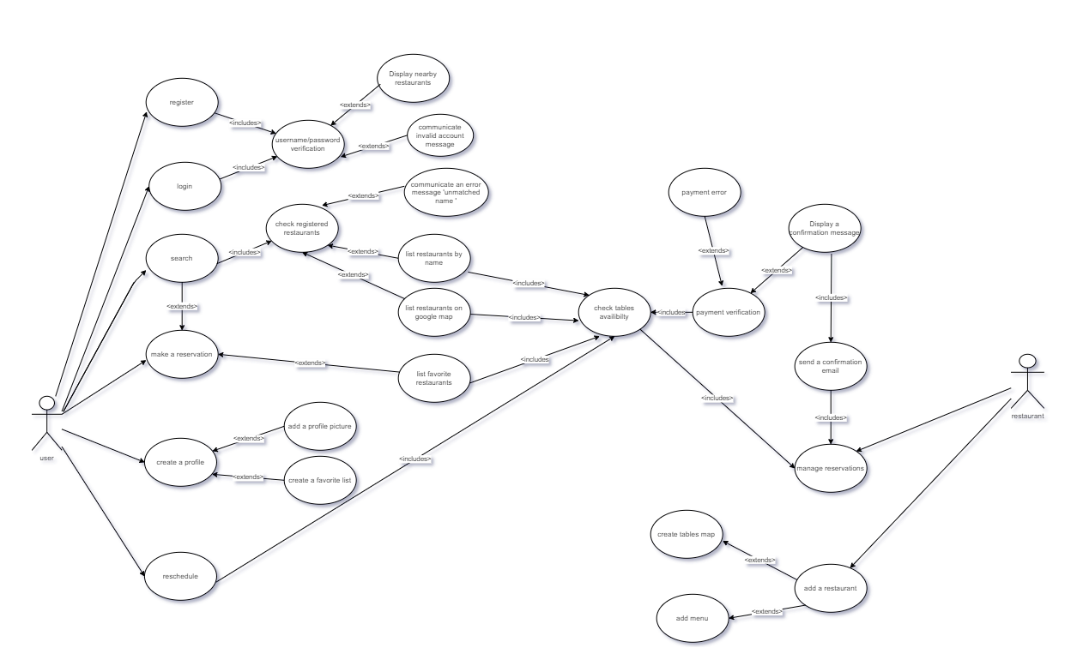

Slide 25
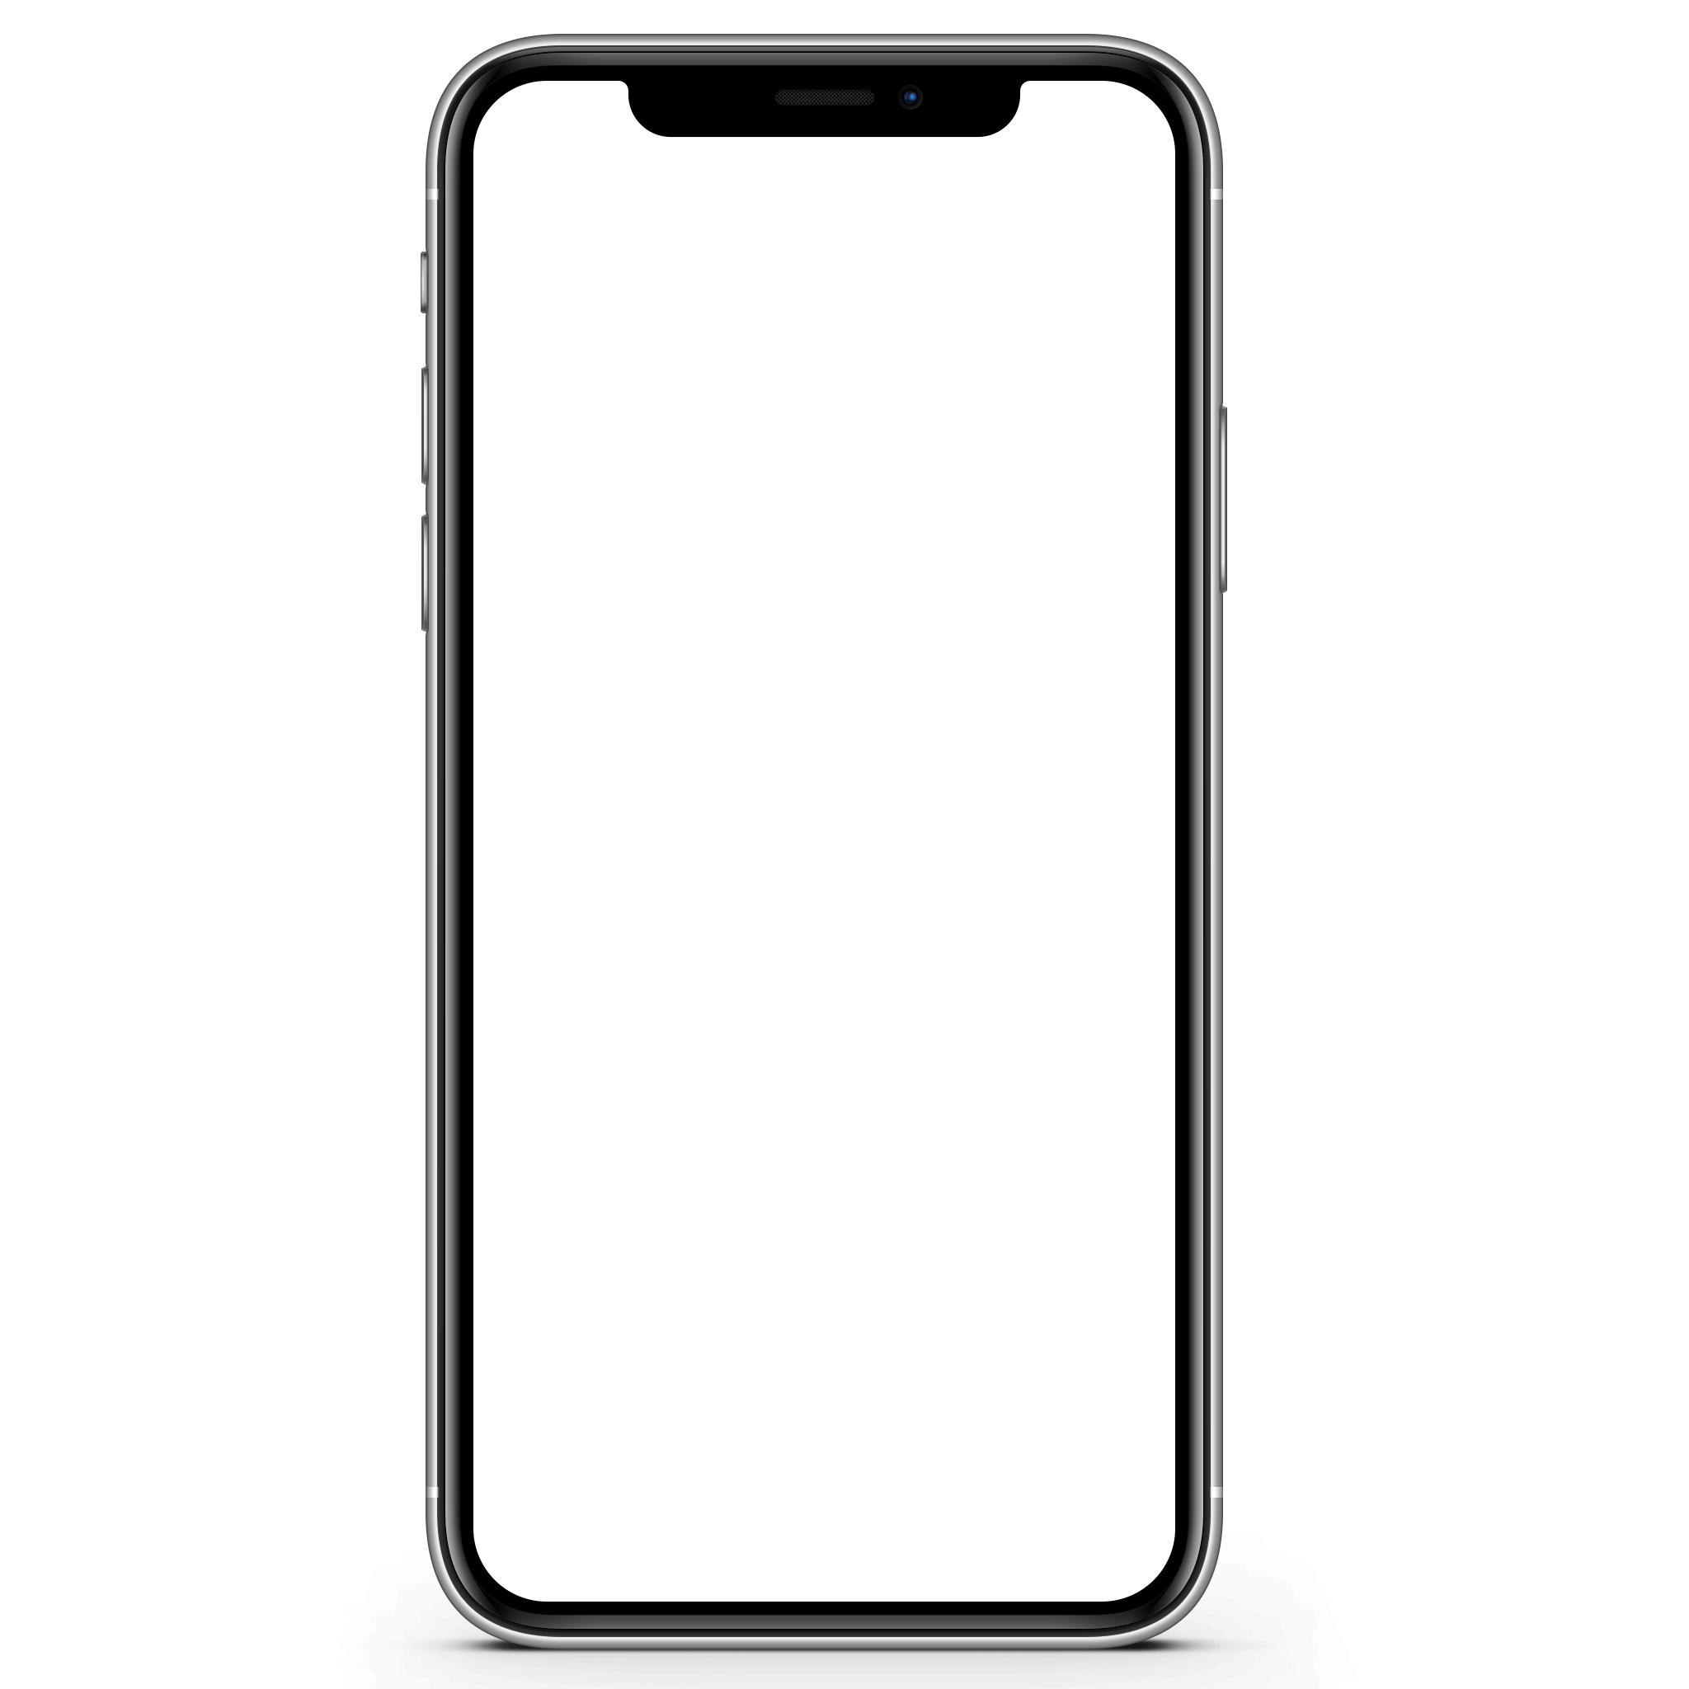
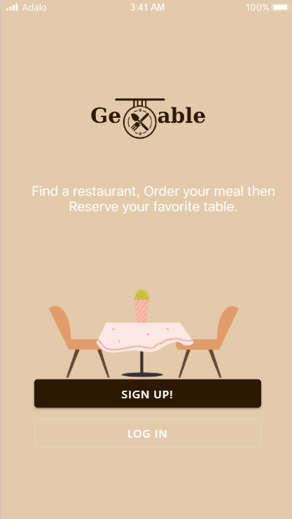
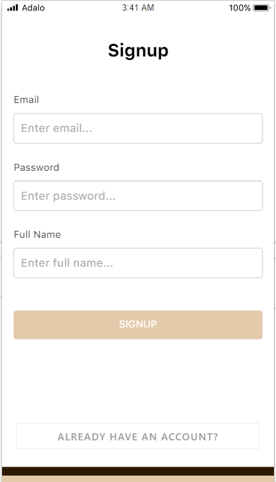

Slide 26
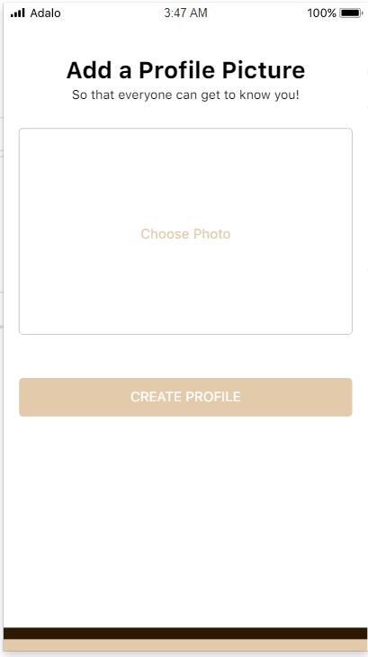
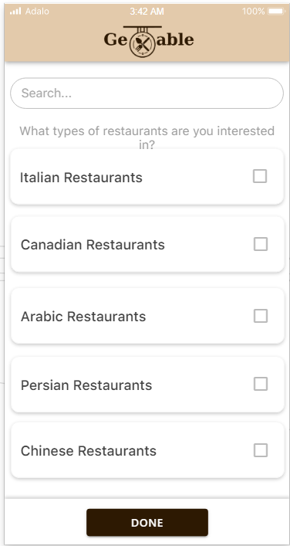

Slide 27
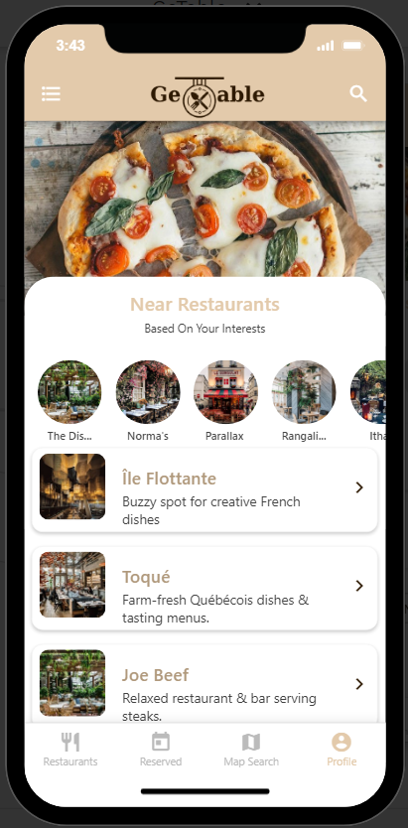
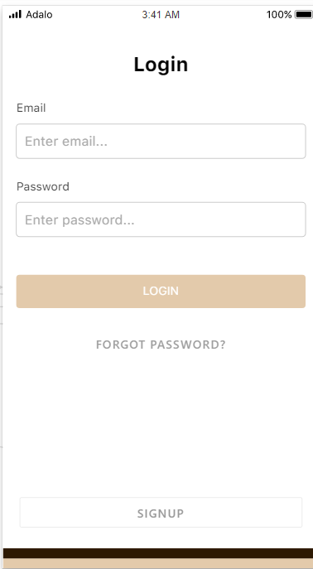

Slide 28
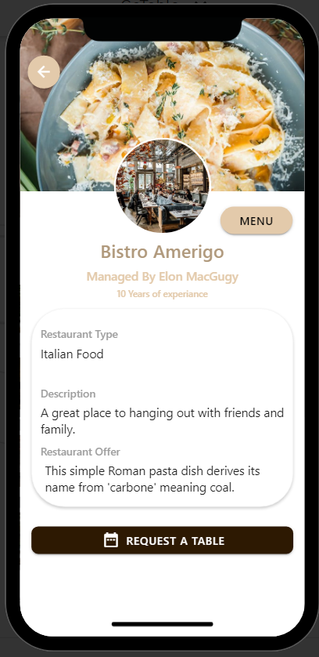
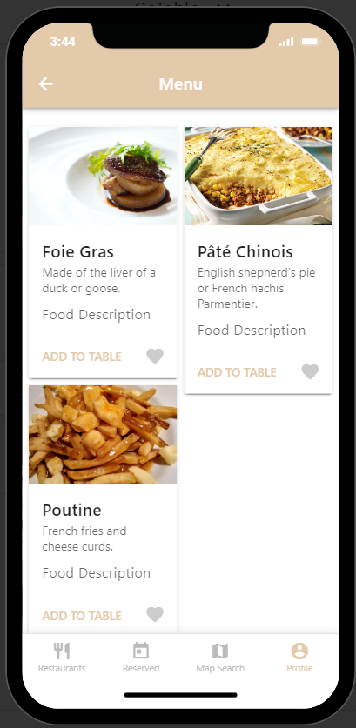
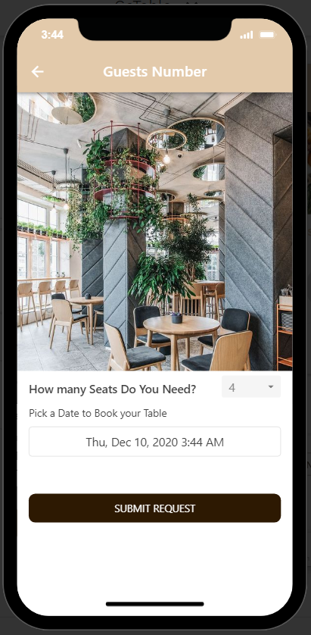

Slide 29
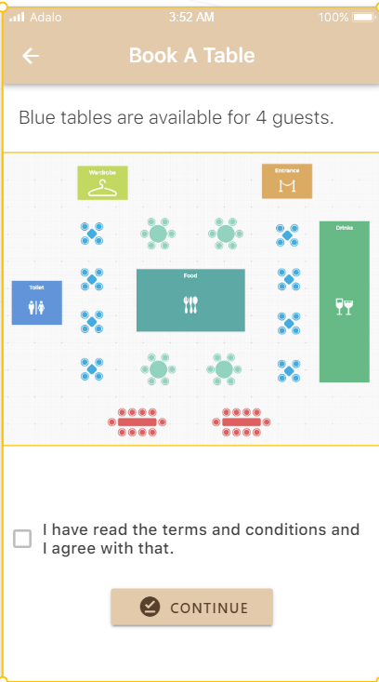
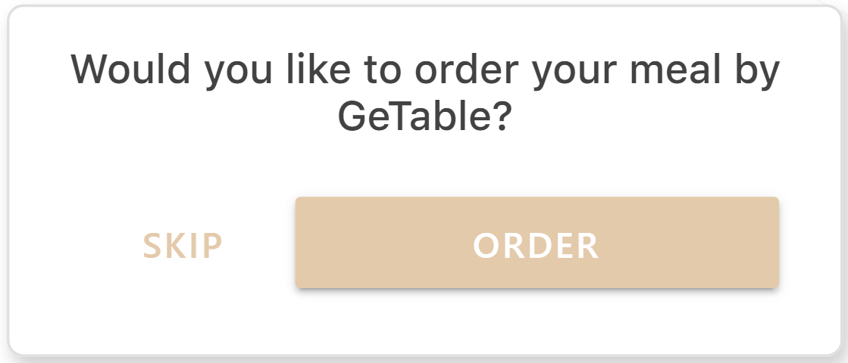

Slide 30
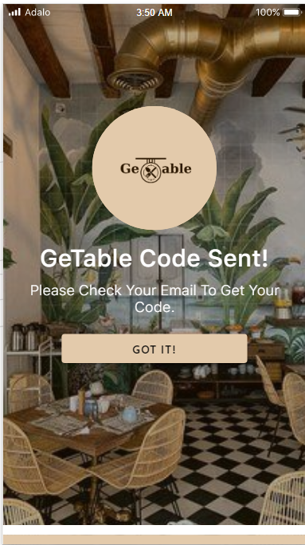

Slide 31
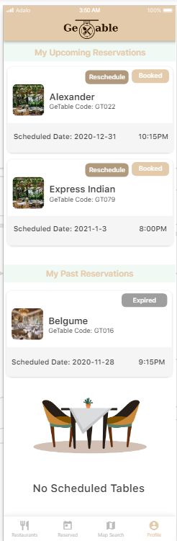
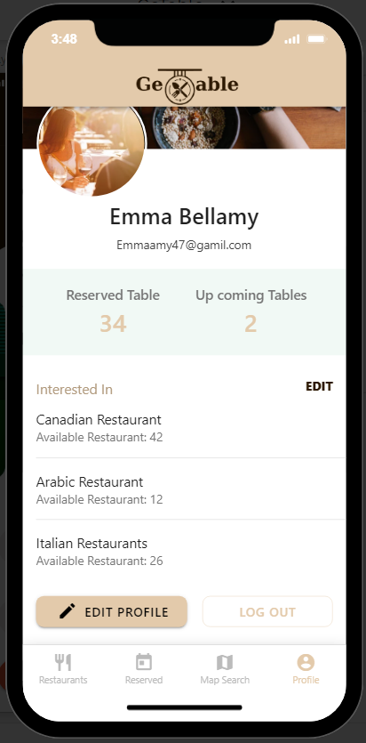
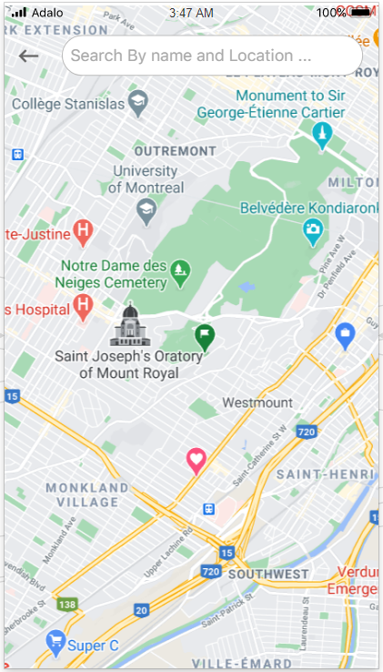

Slide 32
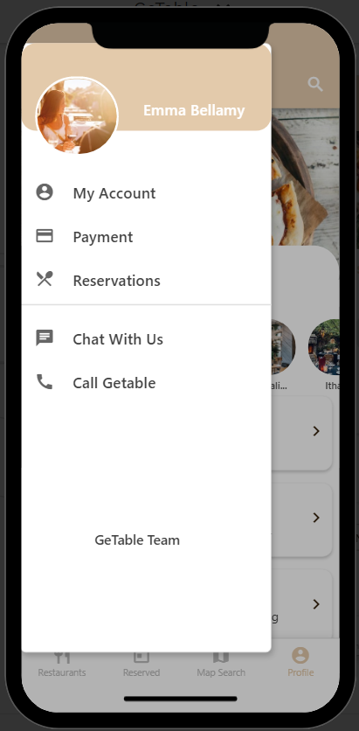
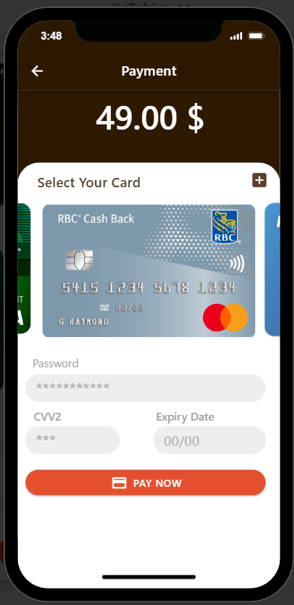
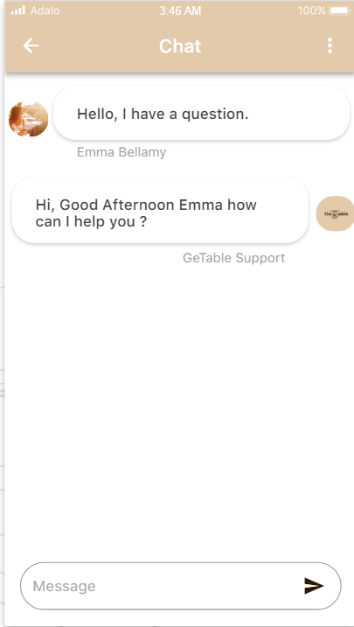

Slide 33
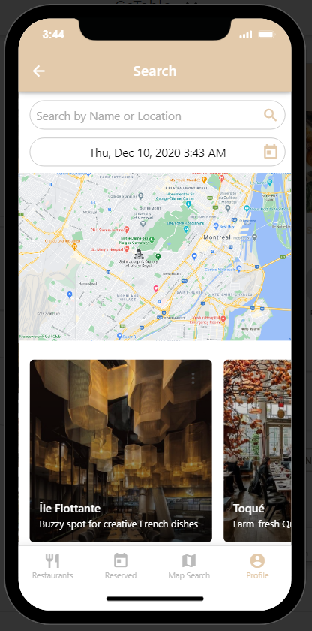
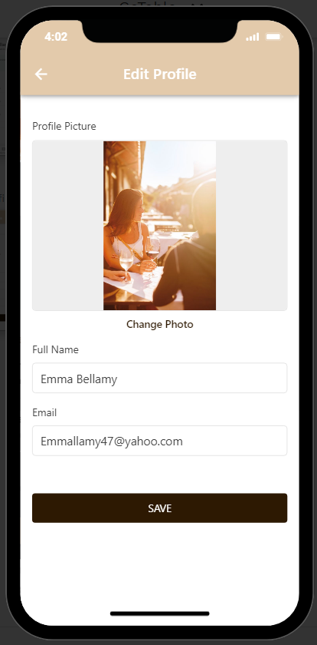
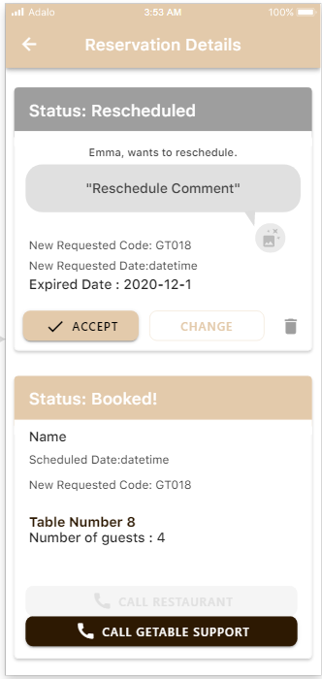

Slide 34
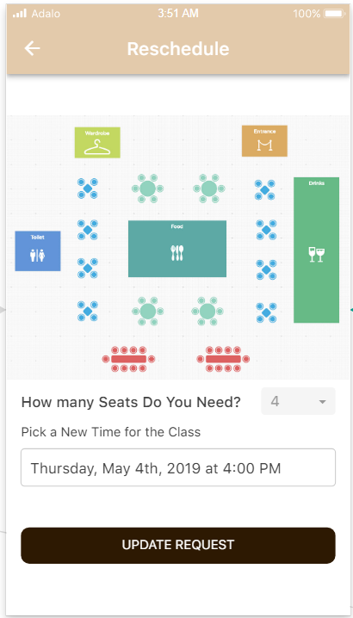
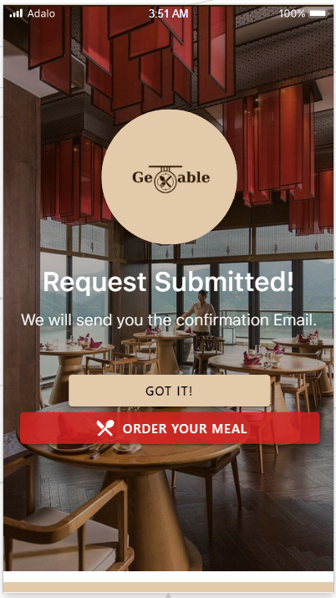

Slide 35
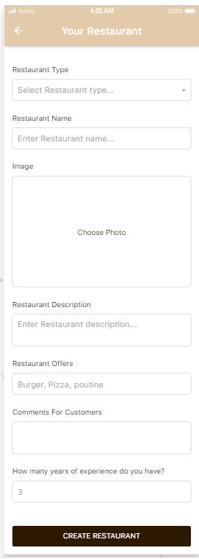
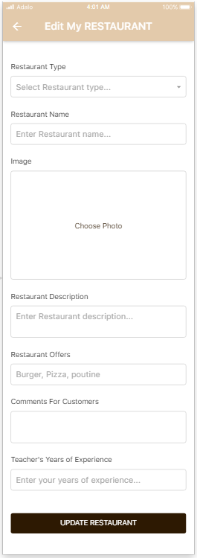
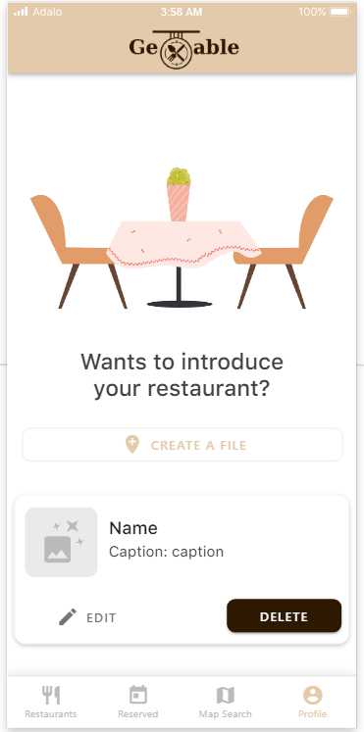

Slide 36
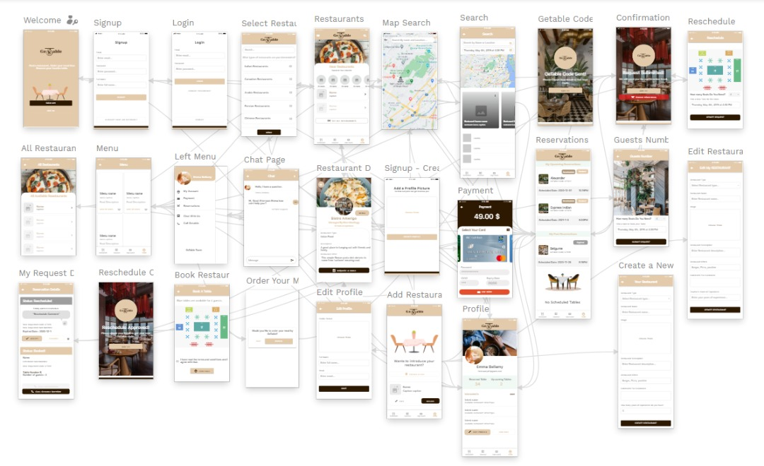

Slide 37

Thank you

